Slide 1





Digital Portfolio
STUDENT NAME: REGISTER NO AND NMID:
RENUKA DEVI .S
2426J0271
DEPARTMENT: COLLEGE: COLLEGE/ UNIVERSITY:
Science/Bharathiyar University.
B.SC INFORMATION TECHNOLOGY
Adithya College of Arts And
1

Slide 2

PROJECT TITLE
Digital portfolio
2

Slide 3


AGENDA
1.Problem Statement 2.Project Overview 3.End Users 4.Tools and Technologies 5.Portfolio design and Layout
6.FeaturesandFunctionality
7.Results and Screenshots 8.Conclusion 9.GithubLink
3/21/2024 AnnualReview
3

Slide 4

PROBLEM STATEMENT
•
In today's digital era, traditional resume
alonearenot enoughto showcaseskills
andprojects effectively.
•Many students and professionals lack a
structured onlinepresence tohighlight
theirwork.
•A Digital portfolio provides an
interactive andaccessibleplatform to
present achievements, skills, andexperiences.
4

Slide 5

PROJECT OVERVIEW
•A Detailed summary of my
project.
•It contains About us, Project,
Skill, Contact.
•Main idea: Showcase
Personal Achievements, skills,Certifications.
5

Slide 6
WHO ARE THE END USERS?
• • • •
Students. Job seekers. Beginners. Professionals.
6

Slide 7


TOOLS AND TECHNIQUES
• • •
HTML -Structure the
webpage.
CSS -Style the page.
JS-Develop interactivity
betweenuser &developer.
•Use visual studio code or
codepenfor
coding.Hosting
paltformongithub.
7

Slide 8


POTFOLIO DESIGN AND LAYOUT
Section Include:
• • • •
•
Home/About us Projects Skills Contacts
Responsive
Layout(mobile,desktop view)
8

Slide 9
FEATURES AND FUNCTIONALITY
•Navigation with smooth
scrolling.
•Project showcase with
images.
•Interactive Elements.
•
Contact form.

Slide 10

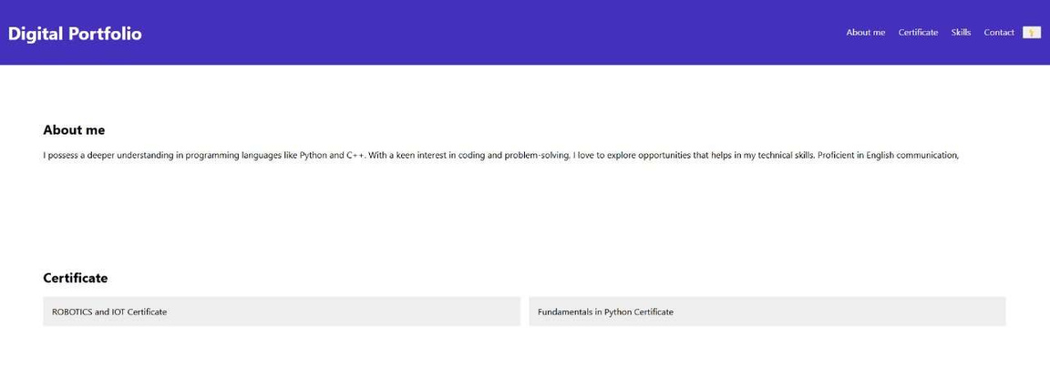
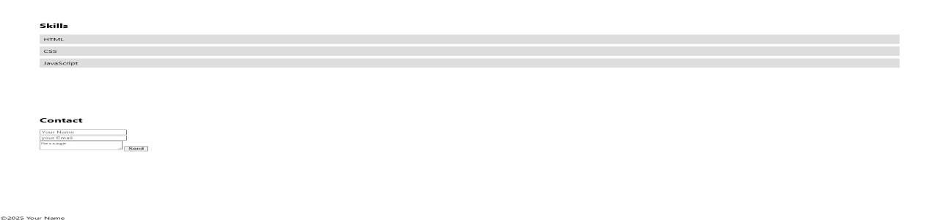
RESULTS AND SCREENSHOTS
3/21/2024 AnnualReview
10

Slide 11

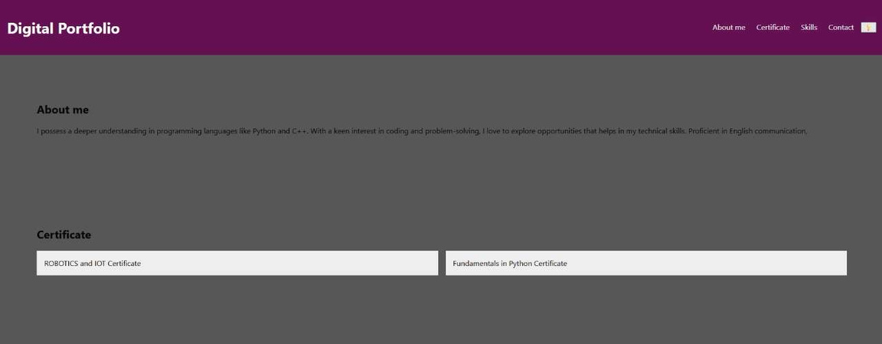
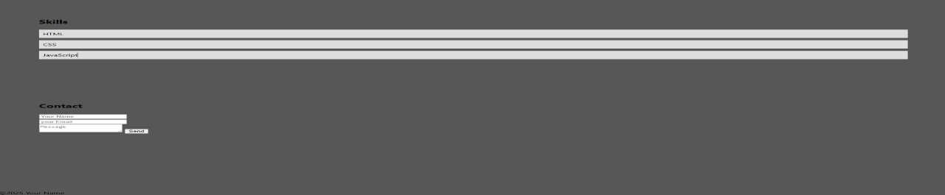
RESULTS AND SCREENSHOTS:
3/21/2024 AnnualReview
11

Slide 12
CONCLUSION
It will help you to develop your personal portfolio easily. It defintelyhelps the people to introduced them formally to theprofessionals.
12

